Slide 1
AI.Data Lab - Group 14: Checkpoint Presentation #1
Data Cleaning Steps - Rotation schedule dataset
Dropped empty rows (no rotation ID = no data), and uninformative columns
Fixed column formats: dates to datetime, numeric fields to int, IDs to string
Standardized status: collapsed Archived/non-Archived variants → Completed (1), Denied (2), Withdrawn (3)
Corrected spelling
Handled "No Students" entries and exploded student lists for student-level analysis

Slide 2
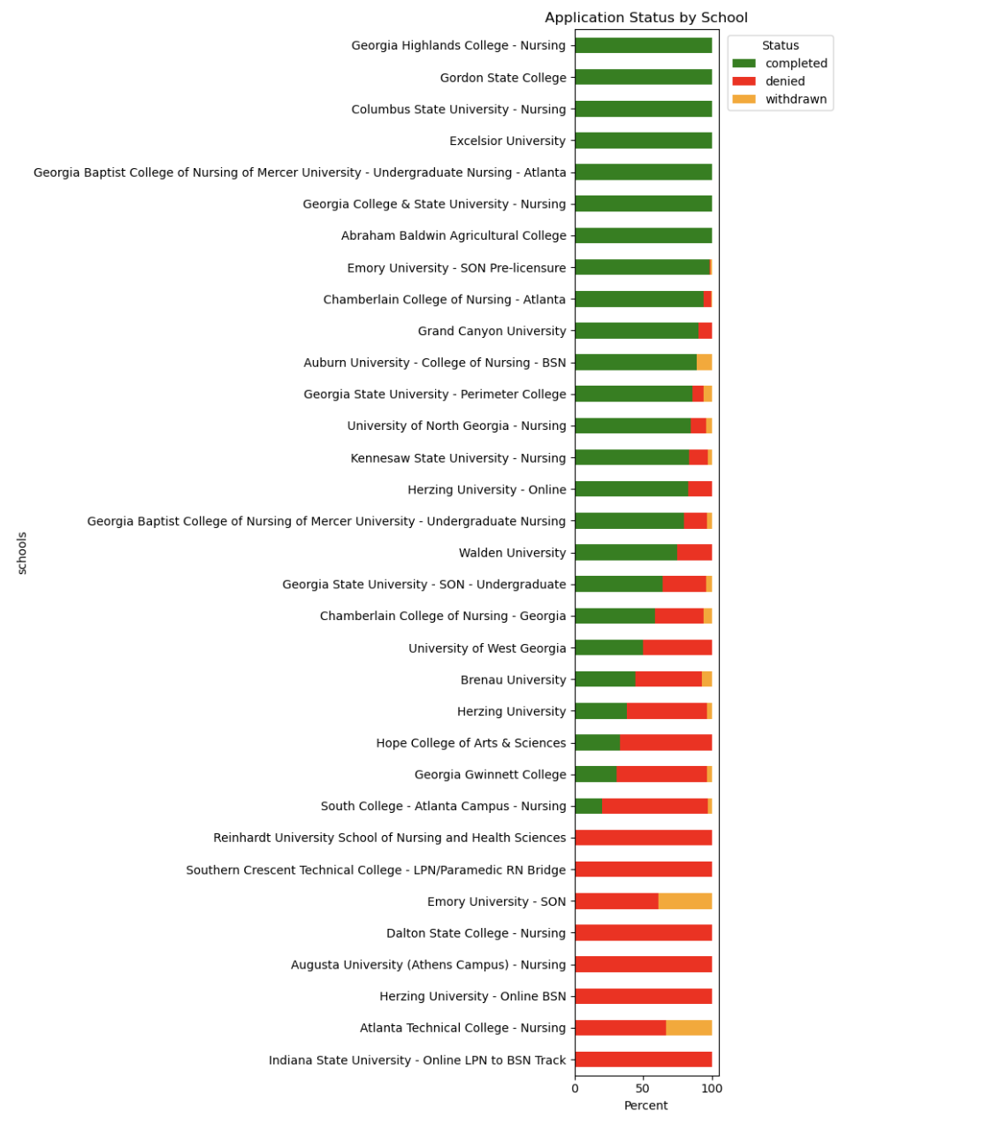
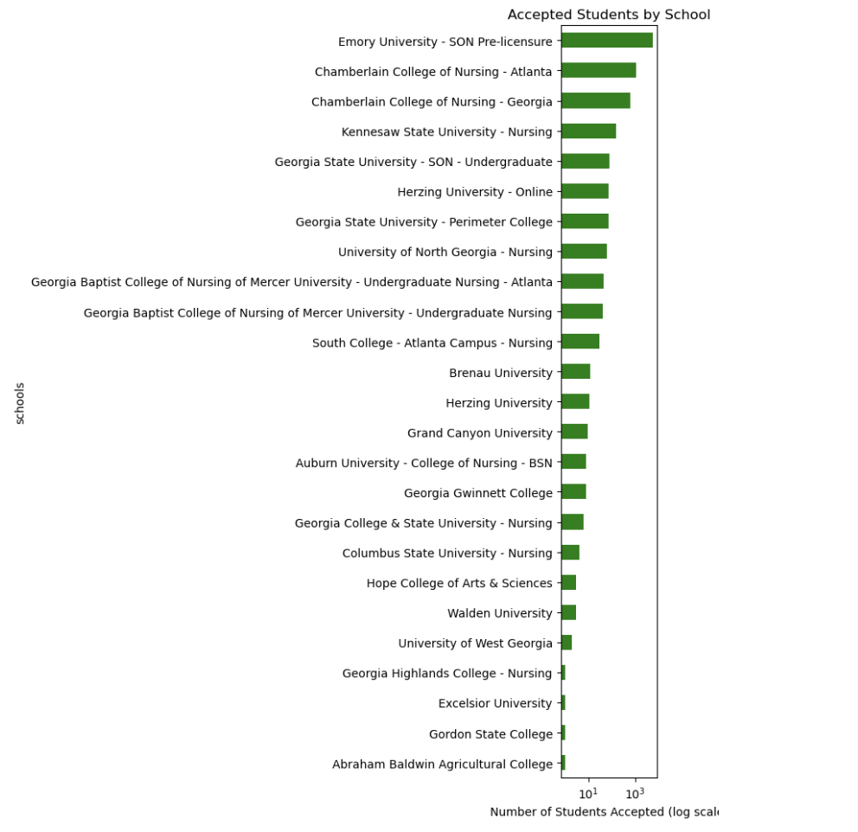
EDA Plots

Slide 3
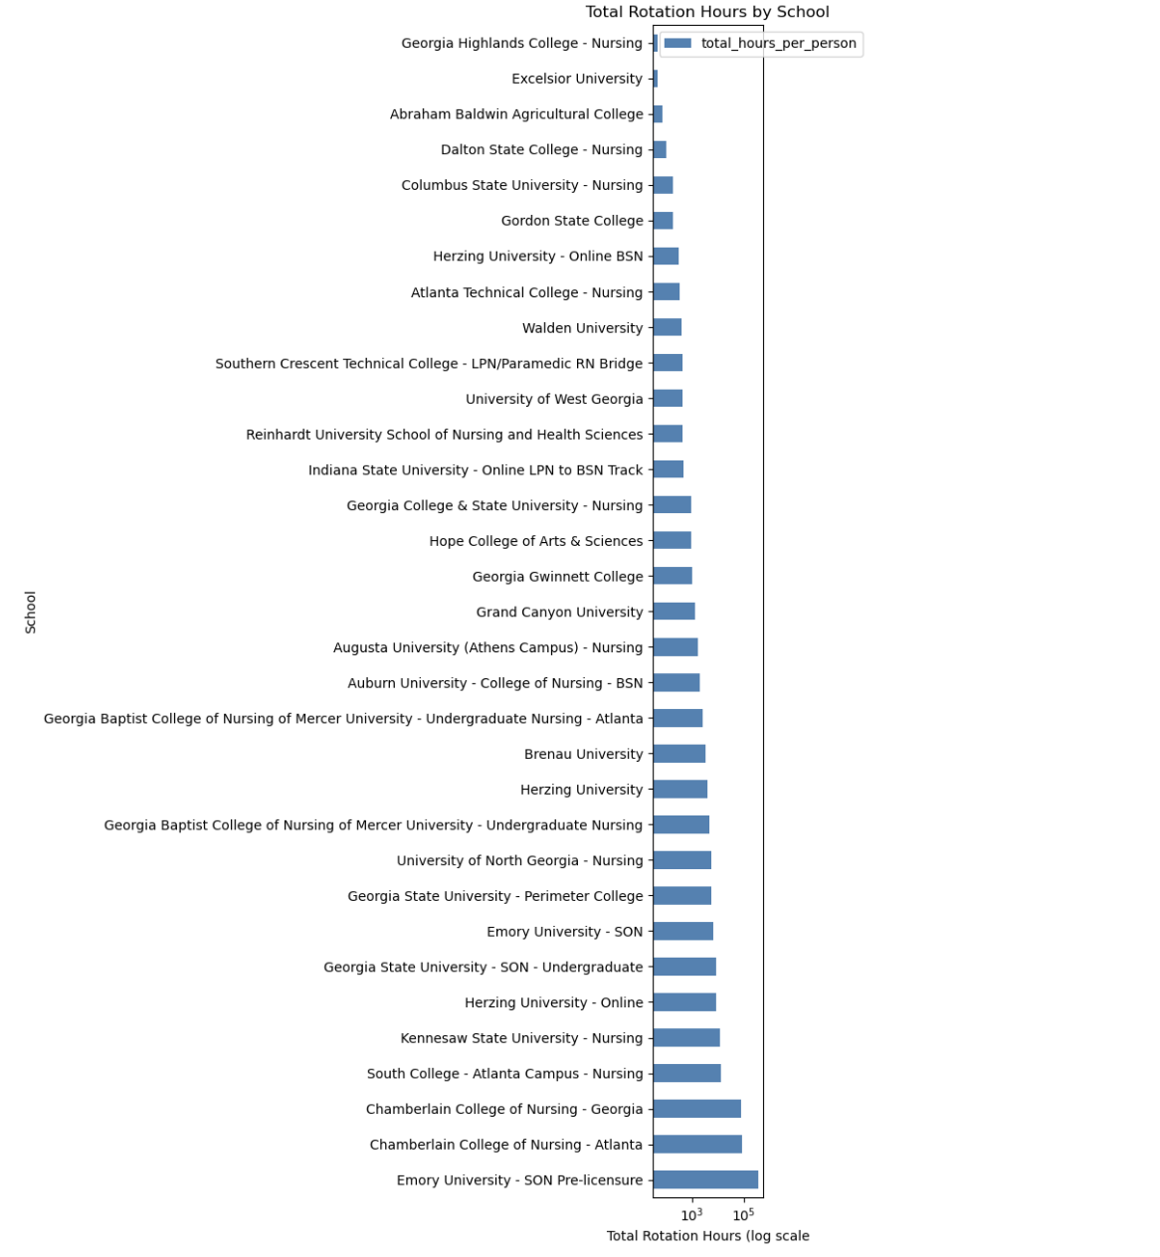
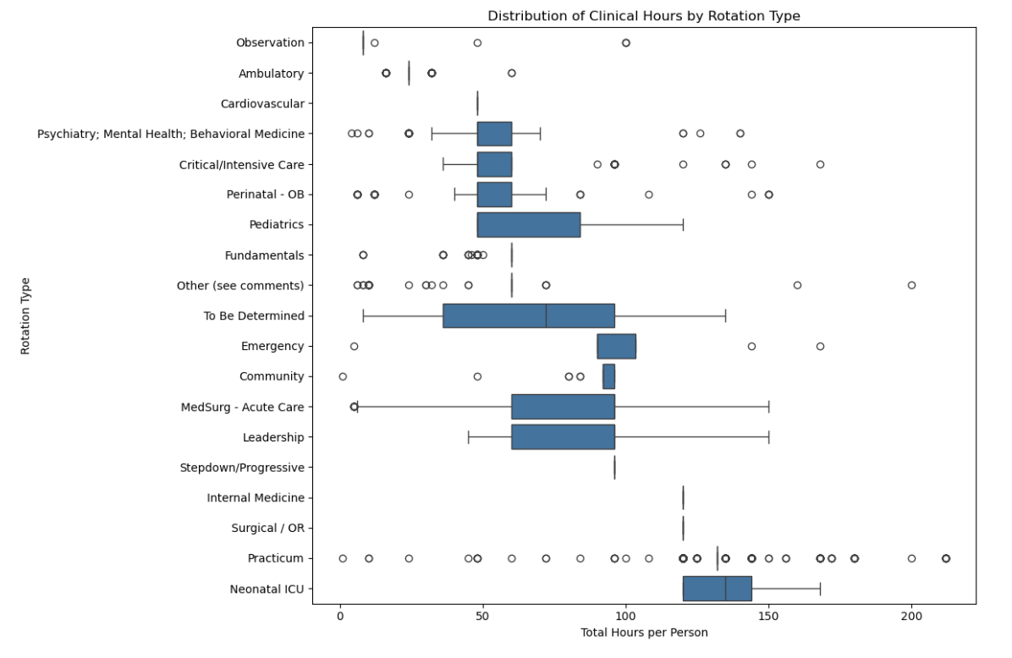
EDA Plots

Slide 5
Next Steps
Integrate richer datasets — rotation hours are a poor proxy for nurse ROC
Verify acceptance rate patterns by school, controlling for rotation type and site
Link rotation type to nurse performance to identify highest-value clinical placements

